Slide 1
Template Book collection
Bloom attempts to make things simple by replacing all the power of normal Page Layout applications (flow, size, format, crop, etc.) with ready-made templates.
So the first step in making a book is looking through the available templates and choosing one to use as the basis for a book.
This mockup does not yet do a good job of distinguishing between Template books and ShellBooks. The former are just book layout aids. In contrast, Shell books have content, and your job is to translate them(health books, for example).

Slide 2
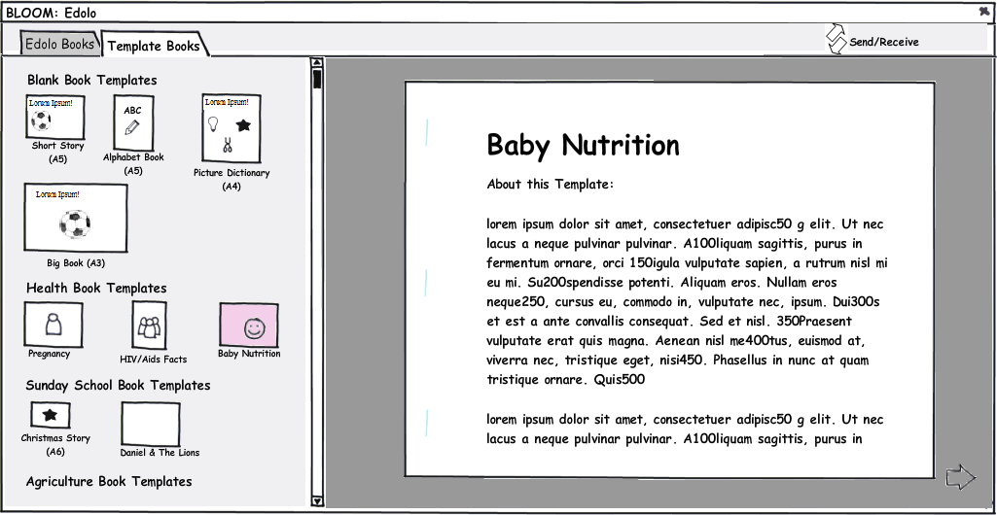

Slide 3
Our book collection
The collection of vernacular books in our library is shown under a tab (Edolo books, in this mockup). Clicking on one lets us preview, edit, or publish it.

Slide 4
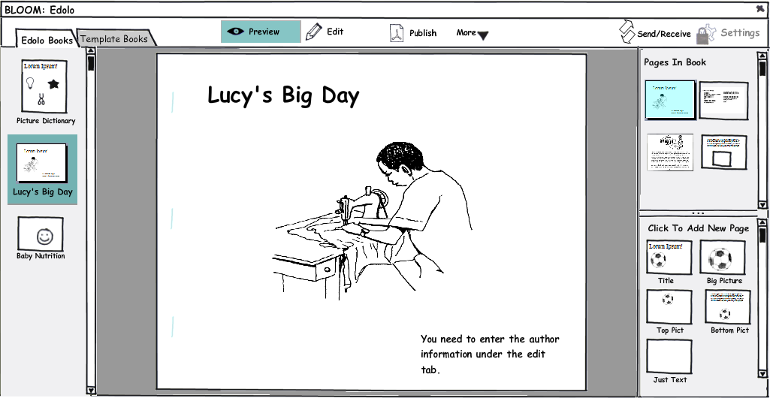

Slide 5
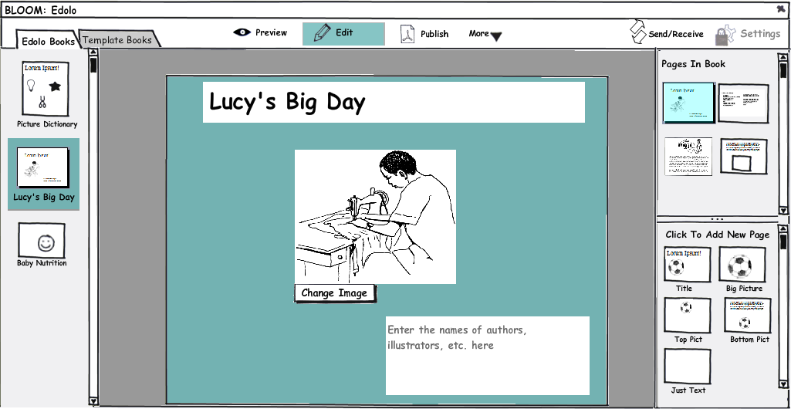

Slide 6
MetaData
An important task in book making is getting all the meta data together. Who holds the copyright? How is it licensed? Who to contact for more copies? ISBN number, etc.
In the following, the “Edit” tab doesn't attempt to give WYSIWYG... instead it is optimized to help you know what to do. Then in “preview”, you see how that data will appear in the printed document.

Slide 7
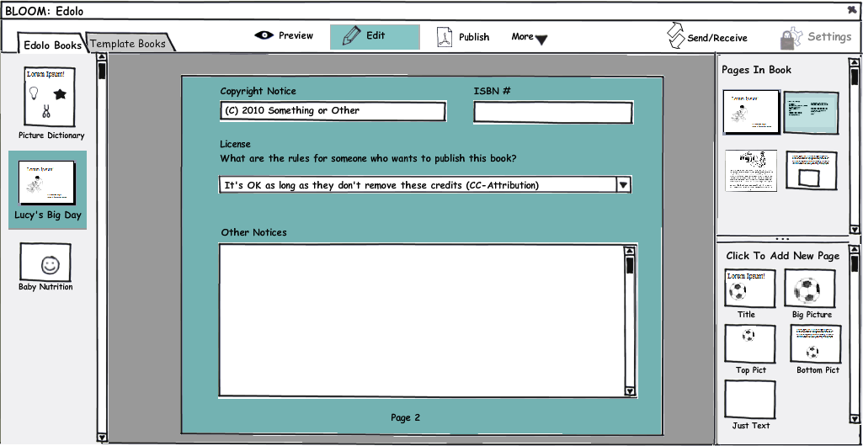

Slide 8
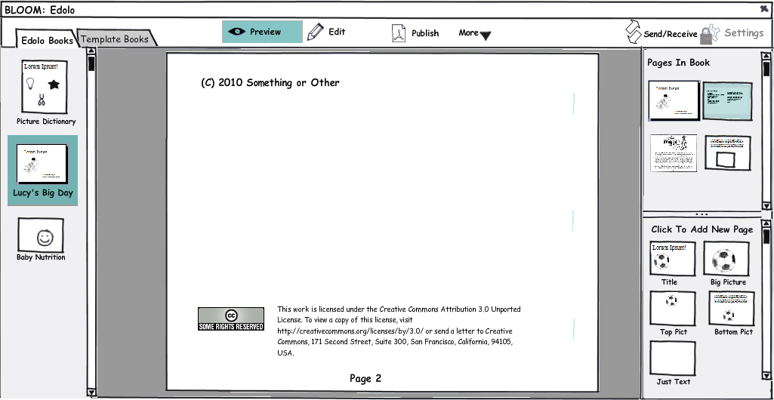

Slide 9
Normal Pages
Ok, so we've seen the title and meta data page (I'm sure there's a real publishing term for that).
The next two pages just show normal contents. With Template books (as opposed to shell books), you click on a page template in the lower right-hand corner to add it to the book. The next slide just shows the preview of a completed page.

Slide 10
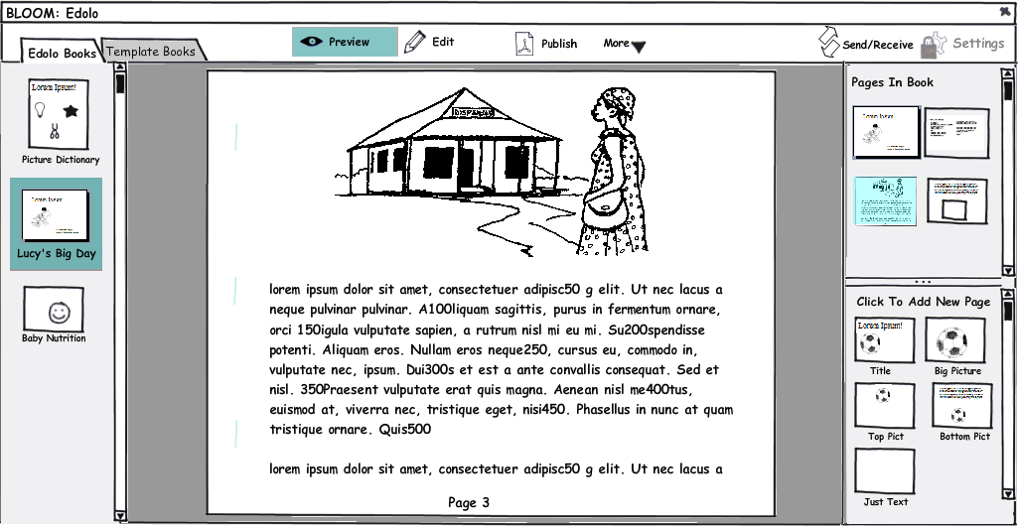

Slide 11
Illustrations
When the template has an illustration frame, it provides buttons for getting the illustration in. The adviser will enable the buttons which make sense for this user. These might include getting a picture from a disk, from a gallery (e.g. Art of Reading), a scanner, or a digital camera (with some automatic filter for turning the image into hi-contrast line art, if that's possible).
We would try to avoid cropping and sizing options, at least initially, doing as much as possible automatically (e.g. expanding the image to fit the frame).

Slide 12
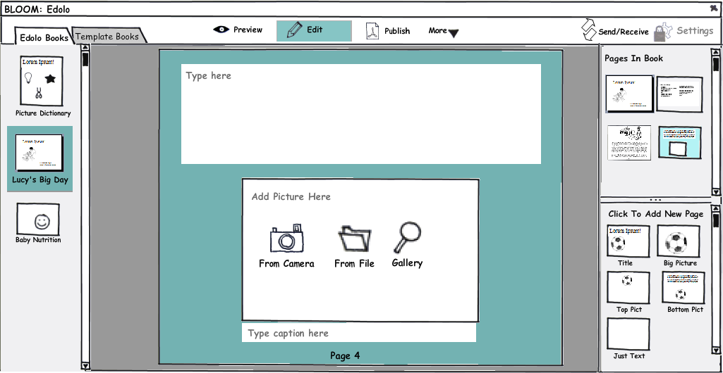

Slide 13
Publish
Here, I'm trying to see how much Bloom could help people with the physical act of printing and assembling books. The following is of course specific to this pesky landscape A5 format of the selected book. Other formats would have different instructions. We could easily include a short video, as well.

Slide 14
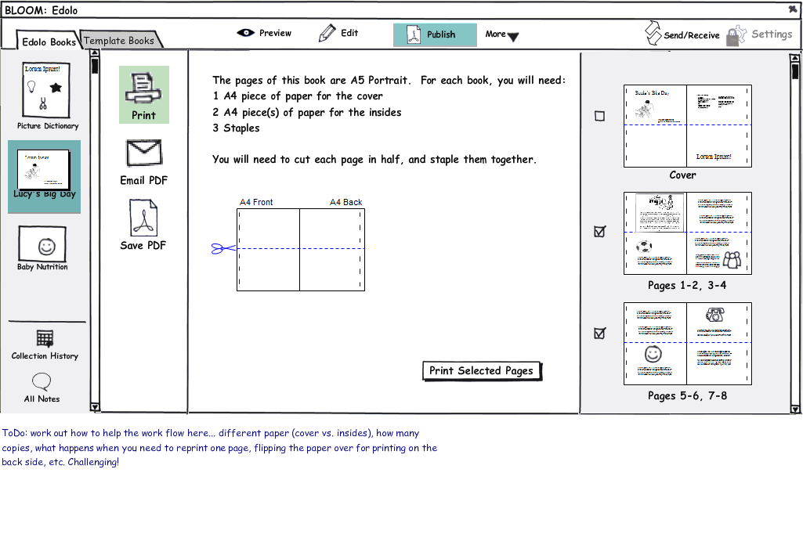

Slide 15
History & Notes
With WeSay, we've now incorporated Distributed Version Control through the Chorus library. In addition to letting a distributed team work together, Chorus opens up the ability to offer History and Notes features.
In the following slides, I look at how that might look if incorporated into Bloom.

Slide 16
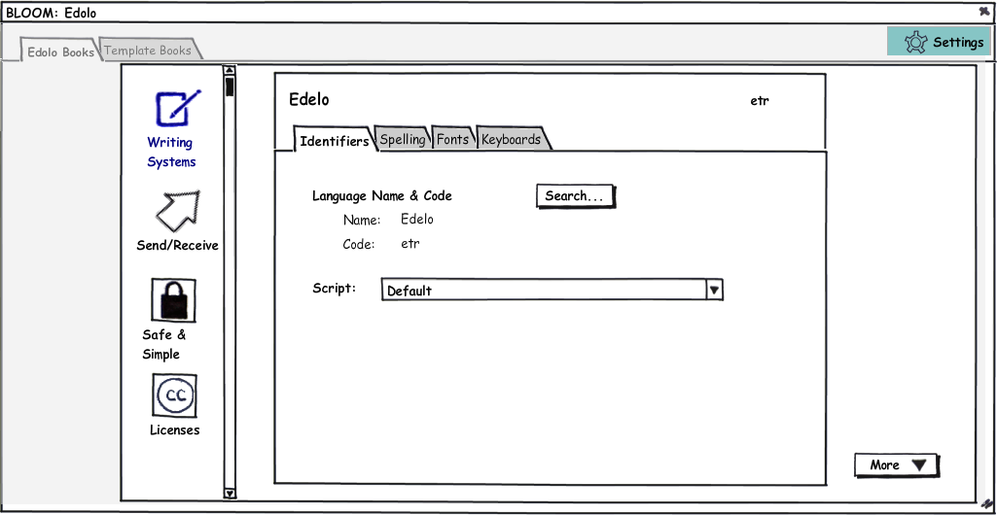

Slide 17
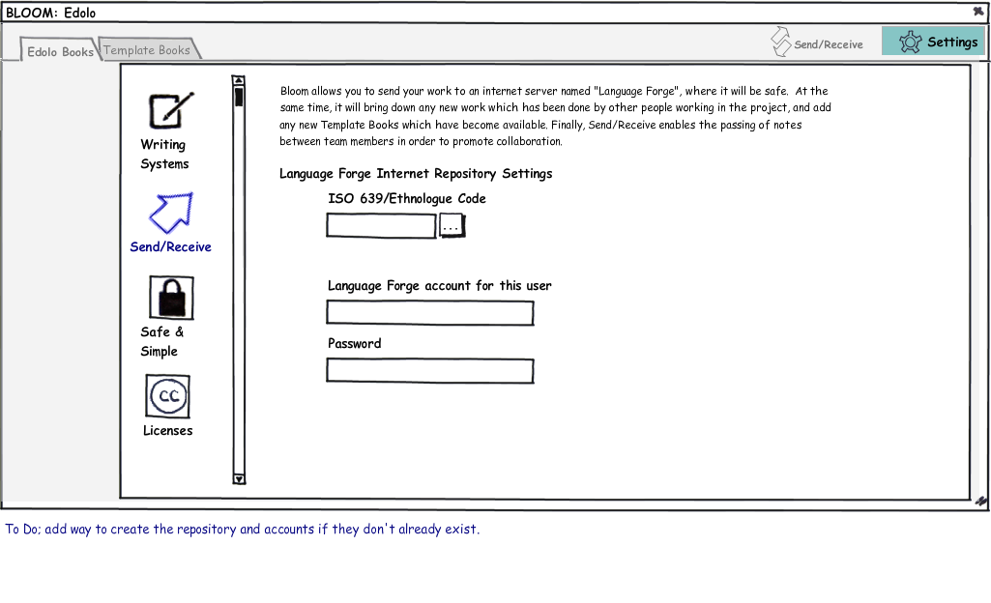

Slide 18
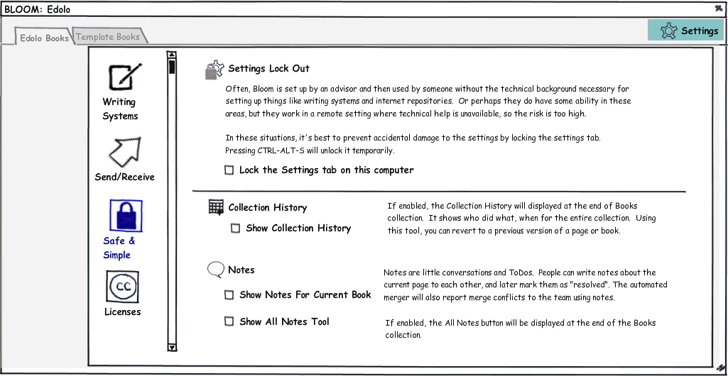

Slide 19
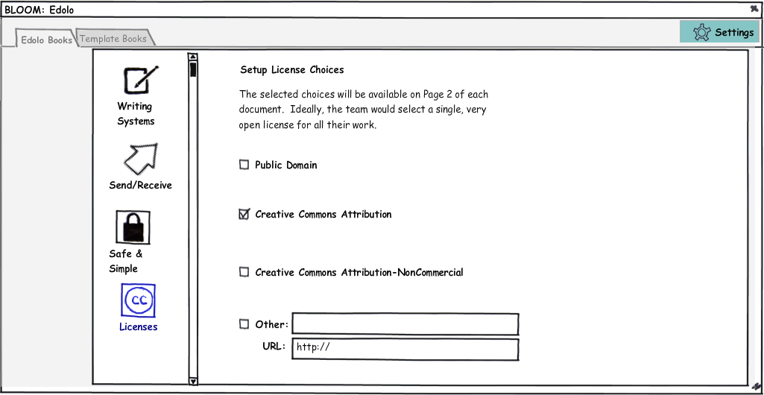

Slide 20
Settings
With WeSay, we had good success with separating the program into 2 parts... the “Configuration Tool” and WeSay itself.
With Bloom, I'm trying to get rid of the separate applications, while keeping the benefits. All settings are under a single tab, which would ordinarily be locked. When locked, the adviser can still get to it by pressing some magic key combination.

Slide 21
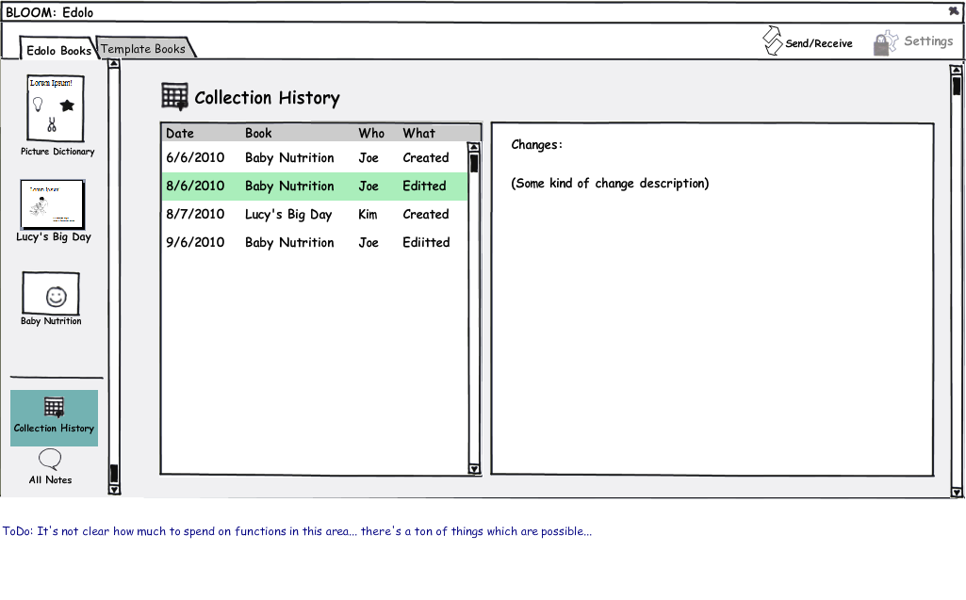

Slide 22
